Slide 1
Azure Boards
Wesley Camargo

Slide 2



Azure Boards
#AzureBoards
aka.ms/azureboards
@AzureDevOps
Notes:
Join the conversation.
Potentially replace for speaker contact details / intro.

Slide 3

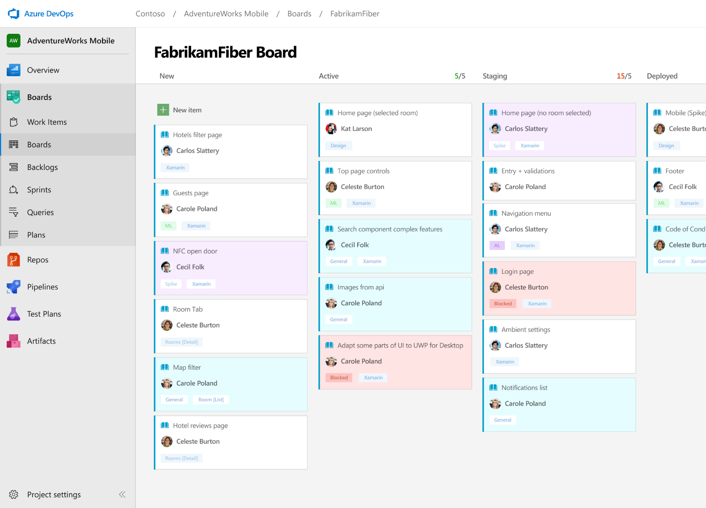



Azure Boards
Track work with Kanban boards, backlogs, team dashboards, and custom reporting.
Connected from idea to release
Track all your ideas at every development stage and keep your team aligned with all code changes linked directly to work items.
Scrum ready
Use built-in scrum boards and planning tools to help your teams run sprints, stand-ups, and planning meetings.
Project insights
Gain new insights into the health and status of your project with powerful analytics tools and dashboard widgets.
Notes:
Combine Kanban boards and drag-and-drop sprint planning with comprehensive traceability and reporting for the perfect home for all your ideas–big and small.

Slide 4

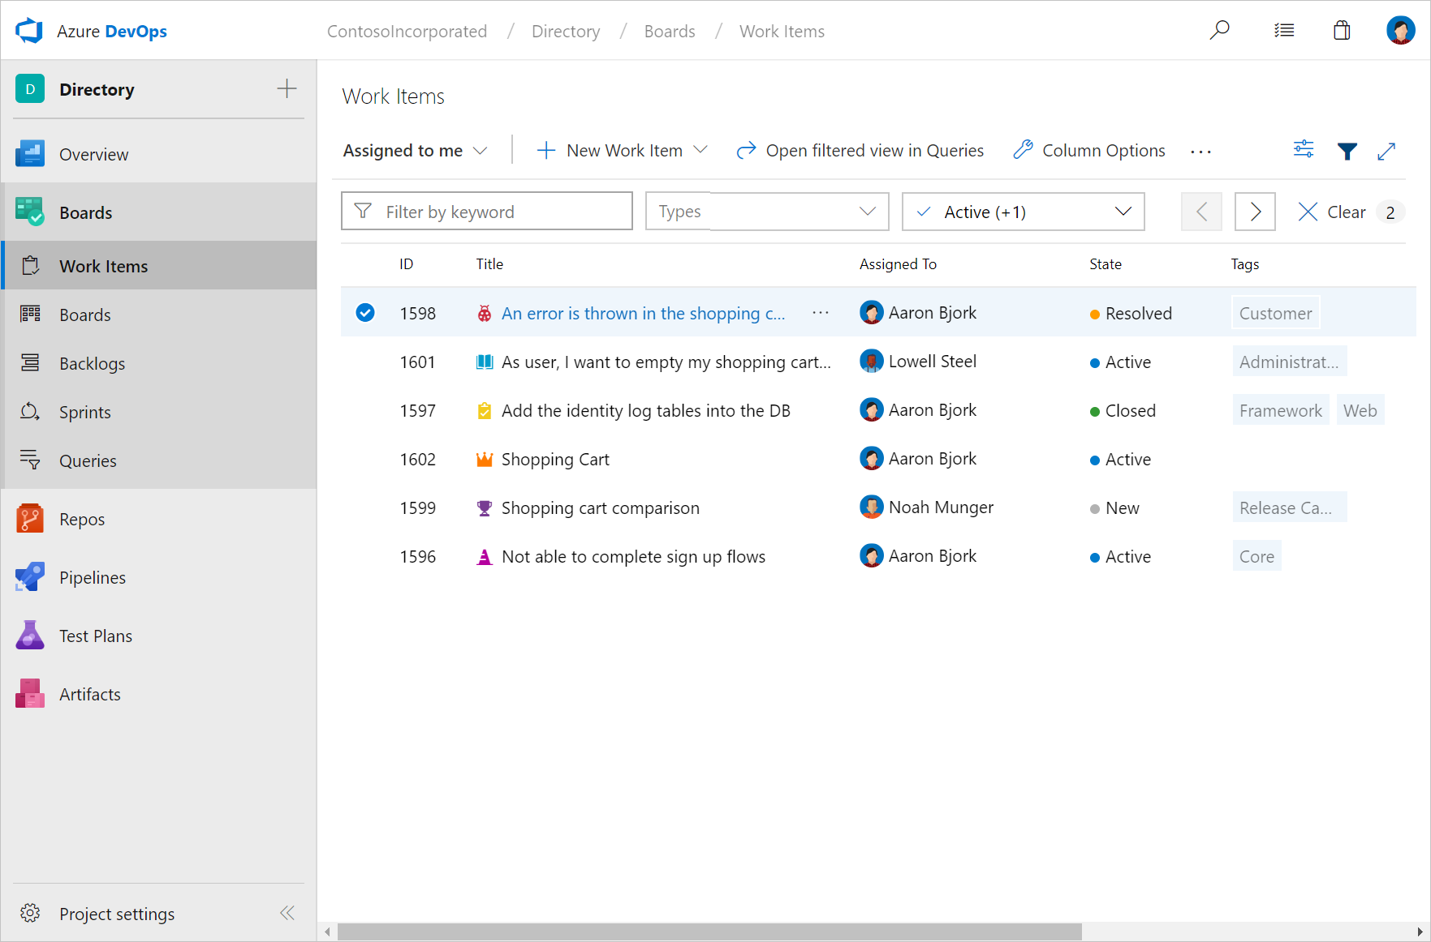

Work Items Hub
Use work items to find and focus on work you care about.

Find work items assigned to you
Track work items that you’re following or have viewed or modified recently.

Rich filtering
Filter work items on types, assignment, states, area, and tags.
Query and Search work items
Query work items within your project or across projects.
Notes:
Mention how queries can also be used to generate charts. Charts provide a preview of what can be pinned to the dashboard.
VSTS Open in Excel for bulk editing of work items
https://marketplace.visualstudio.com/items?itemName=blueprint.vsts-open-work-items-in-excel

Slide 5
Demo
Work Items Hub

Slide 6
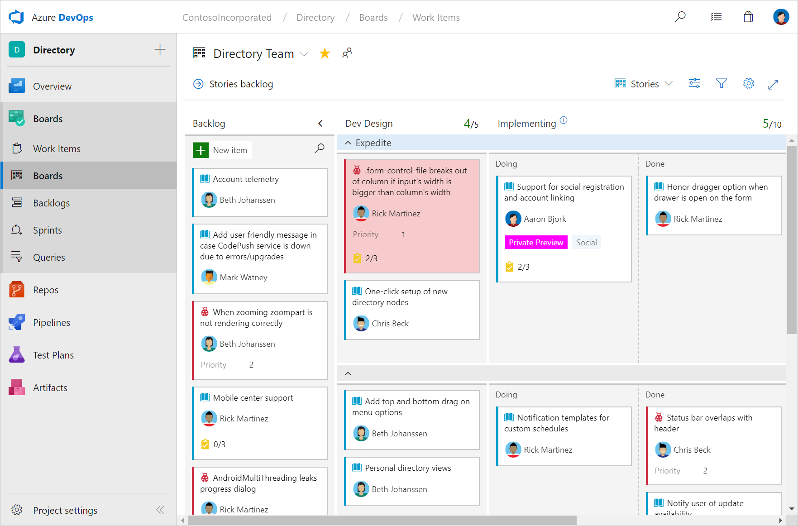


Boards Hub
The pre-configured Kanban board is perfect for managing the flow of your work.

Highly customizable
Customize columns, swim lanes, cards, conditional formatting, filtering, and even WIP limits.
Extensibility through extensions
Add specific features and capabilities to your board with free or paid extensions.
Live updates
See all board changes as they happen.

Slide 7
Demo
Boards Hub

Slide 8
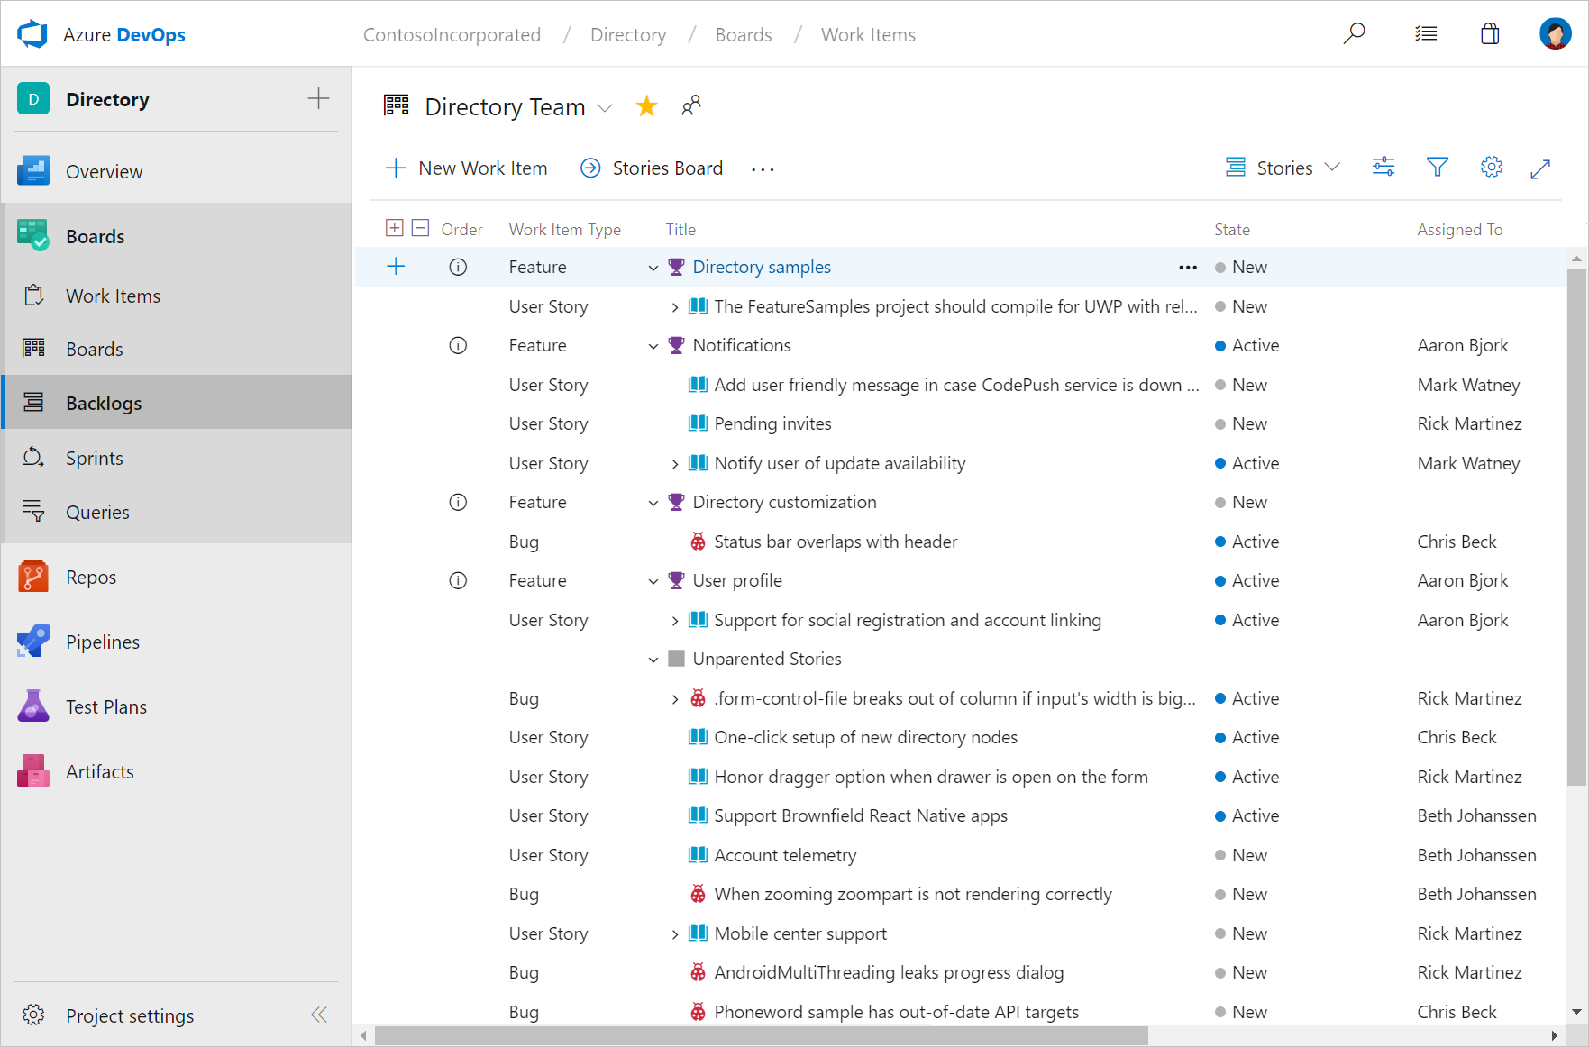
Backlogs Hub
Use your product backlog to quickly plan and prioritize your work.

Prioritize work items
Drag and drop items to adjust the order to help keep things in order of priority.

Manage relationships with hierarchy
After you’ve added features or epics to your portfolio backlog, you can map backlog items to them.
Plan sprints
Use the Plan Sprints pane to quickly assign work to an upcoming sprint.

Slide 9
Demo
Backlogs Hub

Slide 10
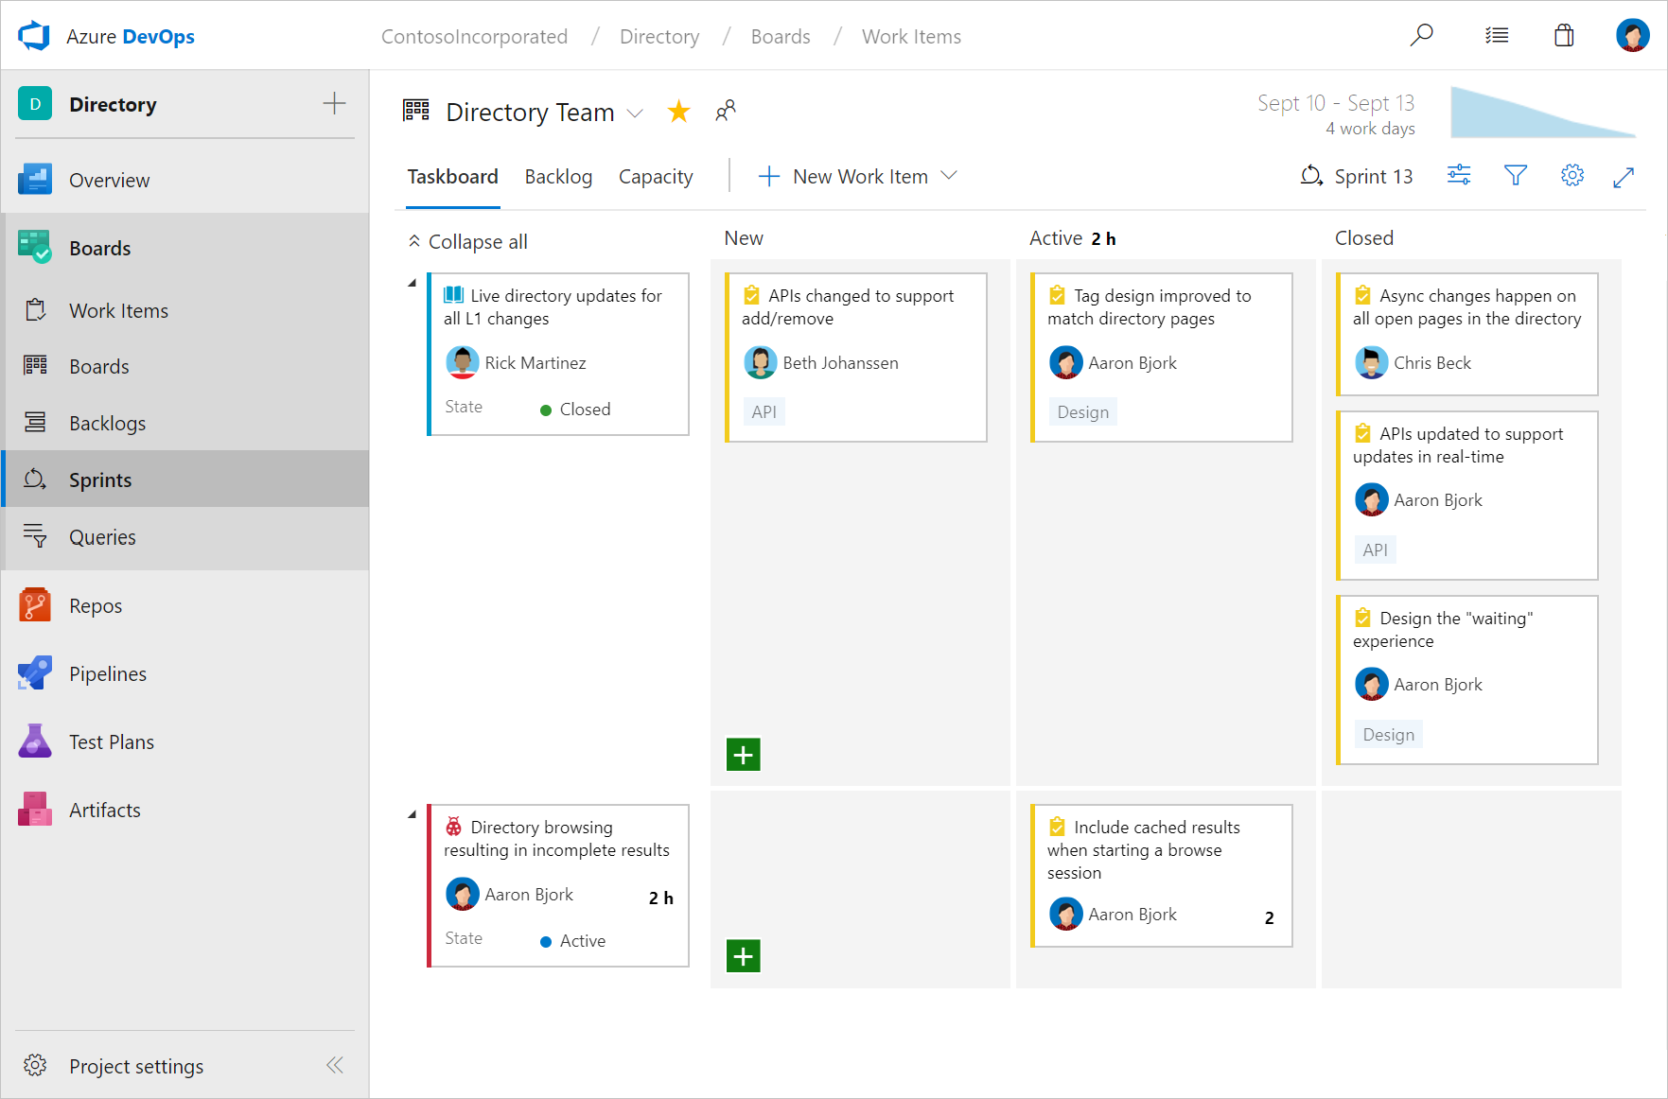

Sprints Hub
Sprints give you the ability to create increments of work for your team to accomplish together.
Taskboard
Use the taskboard in daily Scrum meetings to view progress made to backlog items and tasks.

Capacity Planning
Assign work hours to team members to help you and your team deliver your work on time.
Burndown Chart
Throughout your sprint, you can monitor the sprint burndown chart to determine if your team is on track to complete its sprint plan.

Slide 11
Demo
Sprints Hub

Slide 12
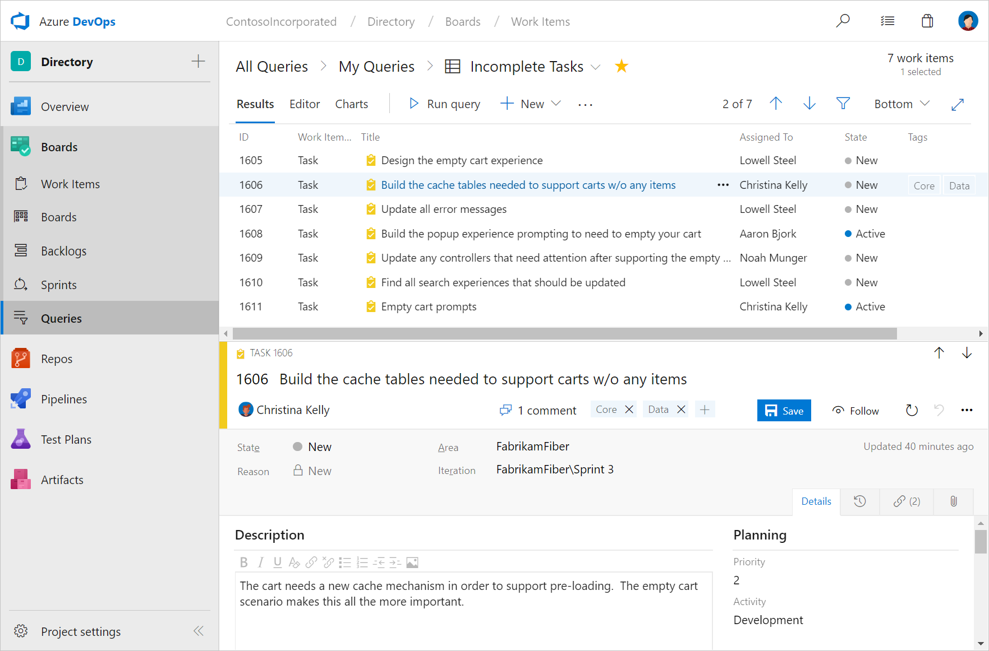
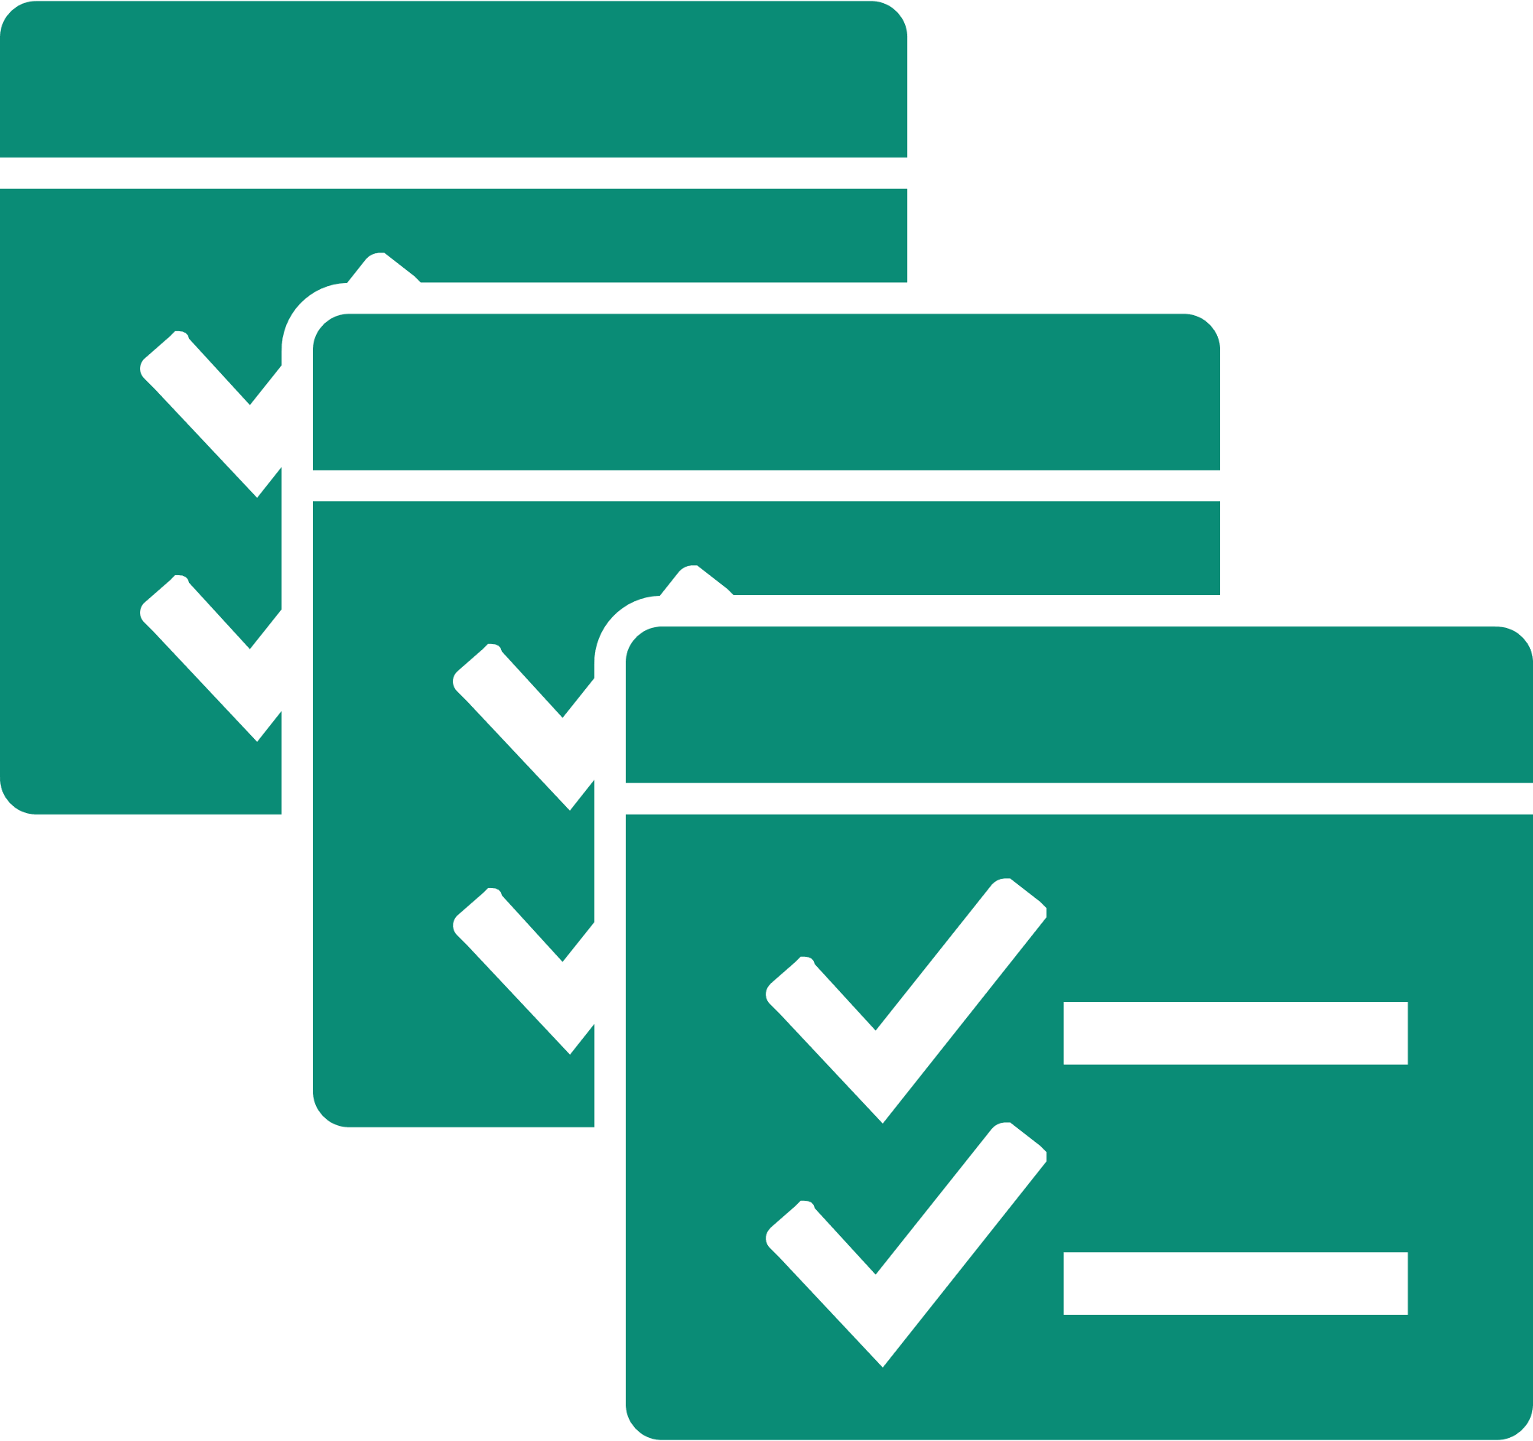
Queries Hub
Tailor exactly what you’re tracking with the query engine.

Cross-project
Create and save queries to track work across different team projects.

Pin to dashboard
Quickly pin queries to dashboards for quick monitoring and status.
Bulk modify work items
Use bulk modify to quickly modify one or more fields for work items.

Slide 13
Demo
Queries Hub

Slide 14
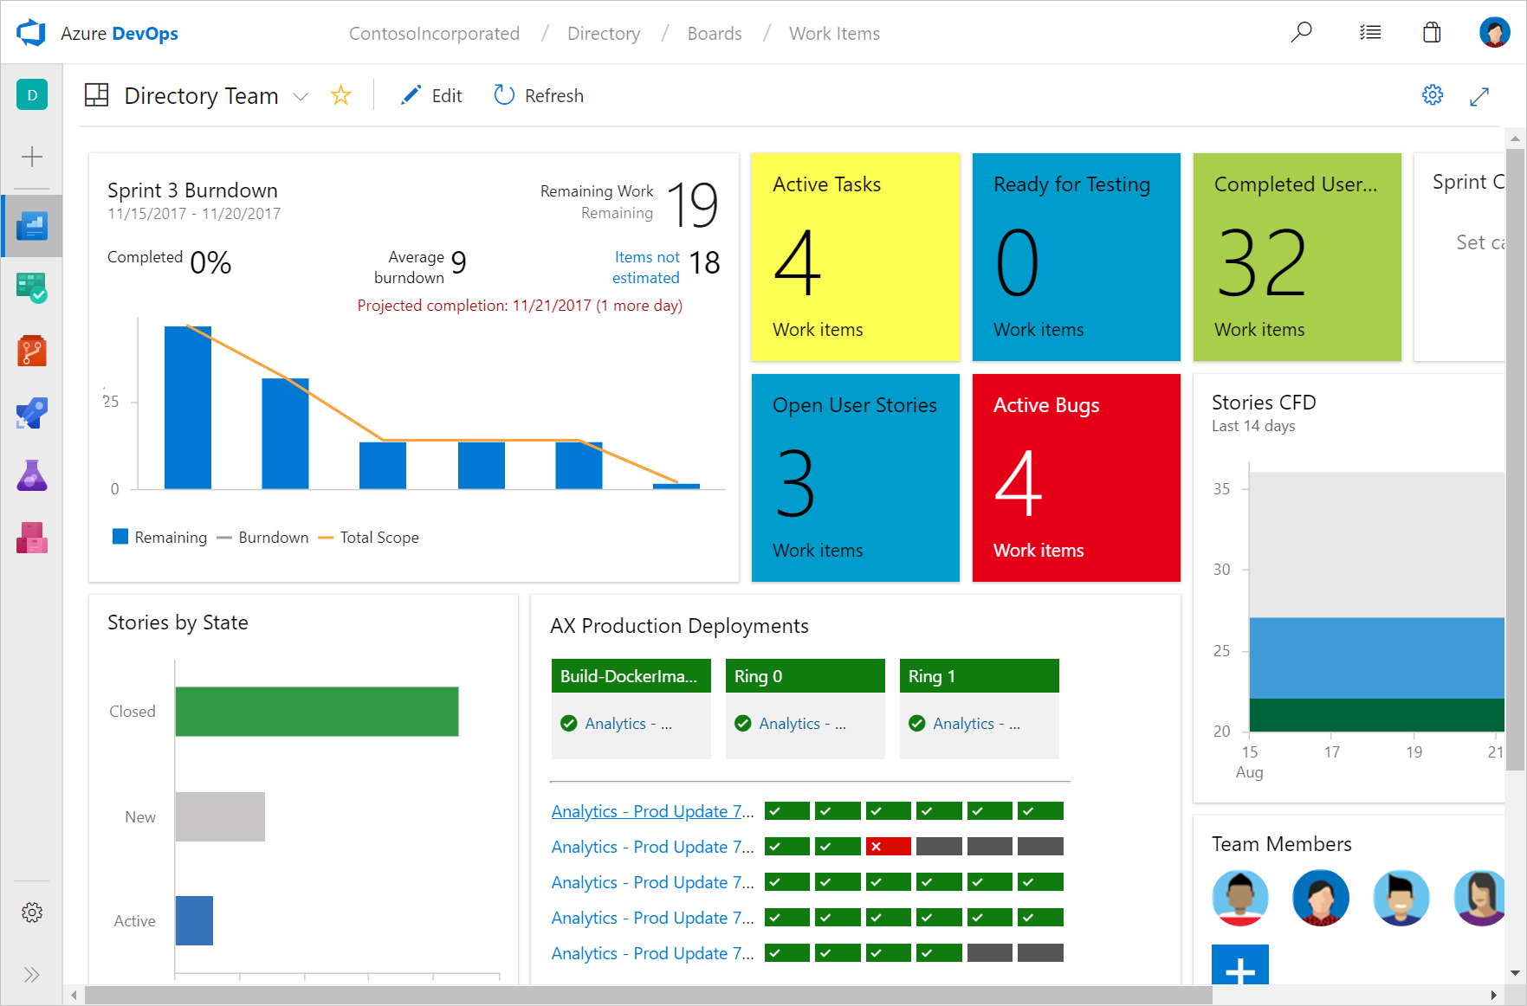

Dashboards
Dashboards give a clear view of what’s happening to track progress and direction.
Real-time information
Dashboards provide easy-to-read, easy access, real-time information
Thriving community of widgets
Widgets smartly format data to provide access to easily consumable data. Add widgets to your team dashboards to gain visibility into the status and trends occurring as you develop your software project.

Add dashboards as needed
Tailor configure the layout that makes sense for your team, and easily monitor progress throughout the lifecycle of your project.

Slide 15
Demo
Dashboards

Slide 16
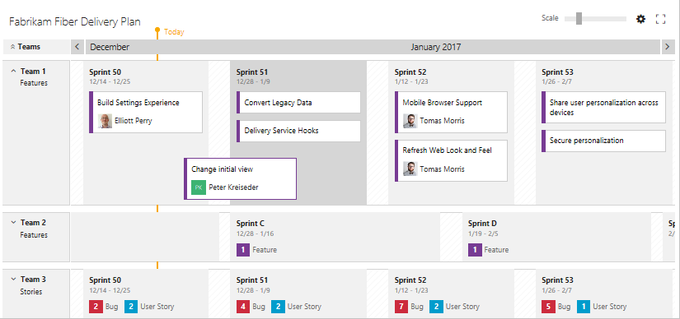



Delivery Plans
Delivery Plans provide the needed multi-team view of your project schedule.
Interactive
You can change the assigned sprint of a work item by dragging it to a new sprint as shown in the following image.
Several parallel teams
You can view multiple backlogs and multiple teams across your whole account
Unified direction
Use Delivery Plans to ensure your teams are aligned with your organizational goals

Slide 17
Demo
Delivery Plans

Slide 18





Deliver
with Azure DevOps
Azure Boards
Azure Repos
Azure Pipelines
Azure Artifacts
Azure Test Plans

Slide 19

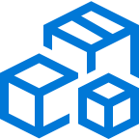



Azure DevOps
Plan smarter, collaborate better, and ship faster with a set of modern dev services
Any developer, any platform, any cloud. Full support for hybrid cloud, on-premises & containers.
Use all the Azure DevOps services or choose just what you need to complement your existing workflows
Best in class builds for open source. Free unlimited build minutes for public projects and up to 10 free concurrent jobs across Windows, Linux and macOS
Get started for free for small teams, scales to support the largest enterprises
Azure Boards
Azure Repos
Azure Pipelines
Azure Test Plans
Azure Artifacts
Start free today
➔
https://azure.com/devops

Slide 20













Broadening the Azure Ecosystem
Notes:
So does TFS

Slide 21

Thank You

